Slide 1
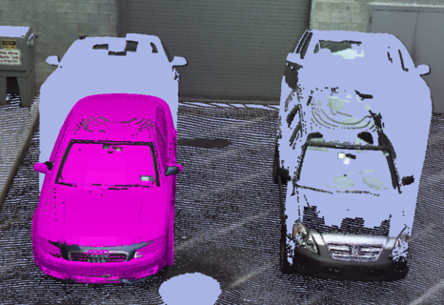
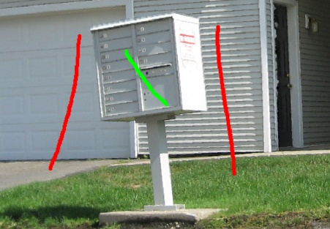
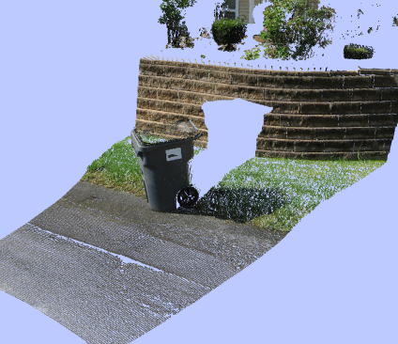
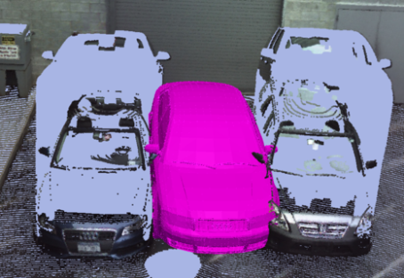
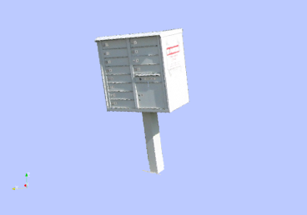
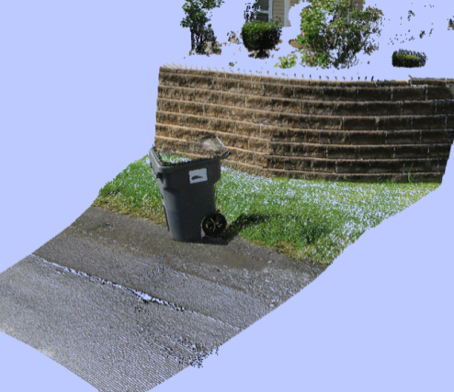
LiDAR Data Manipulation: Object Detection, Segmentation, and Inpainting
Doctoral Thesis Defense
David Doria, November 2012

Slide 2
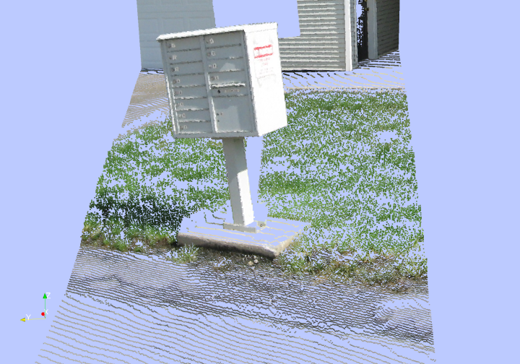
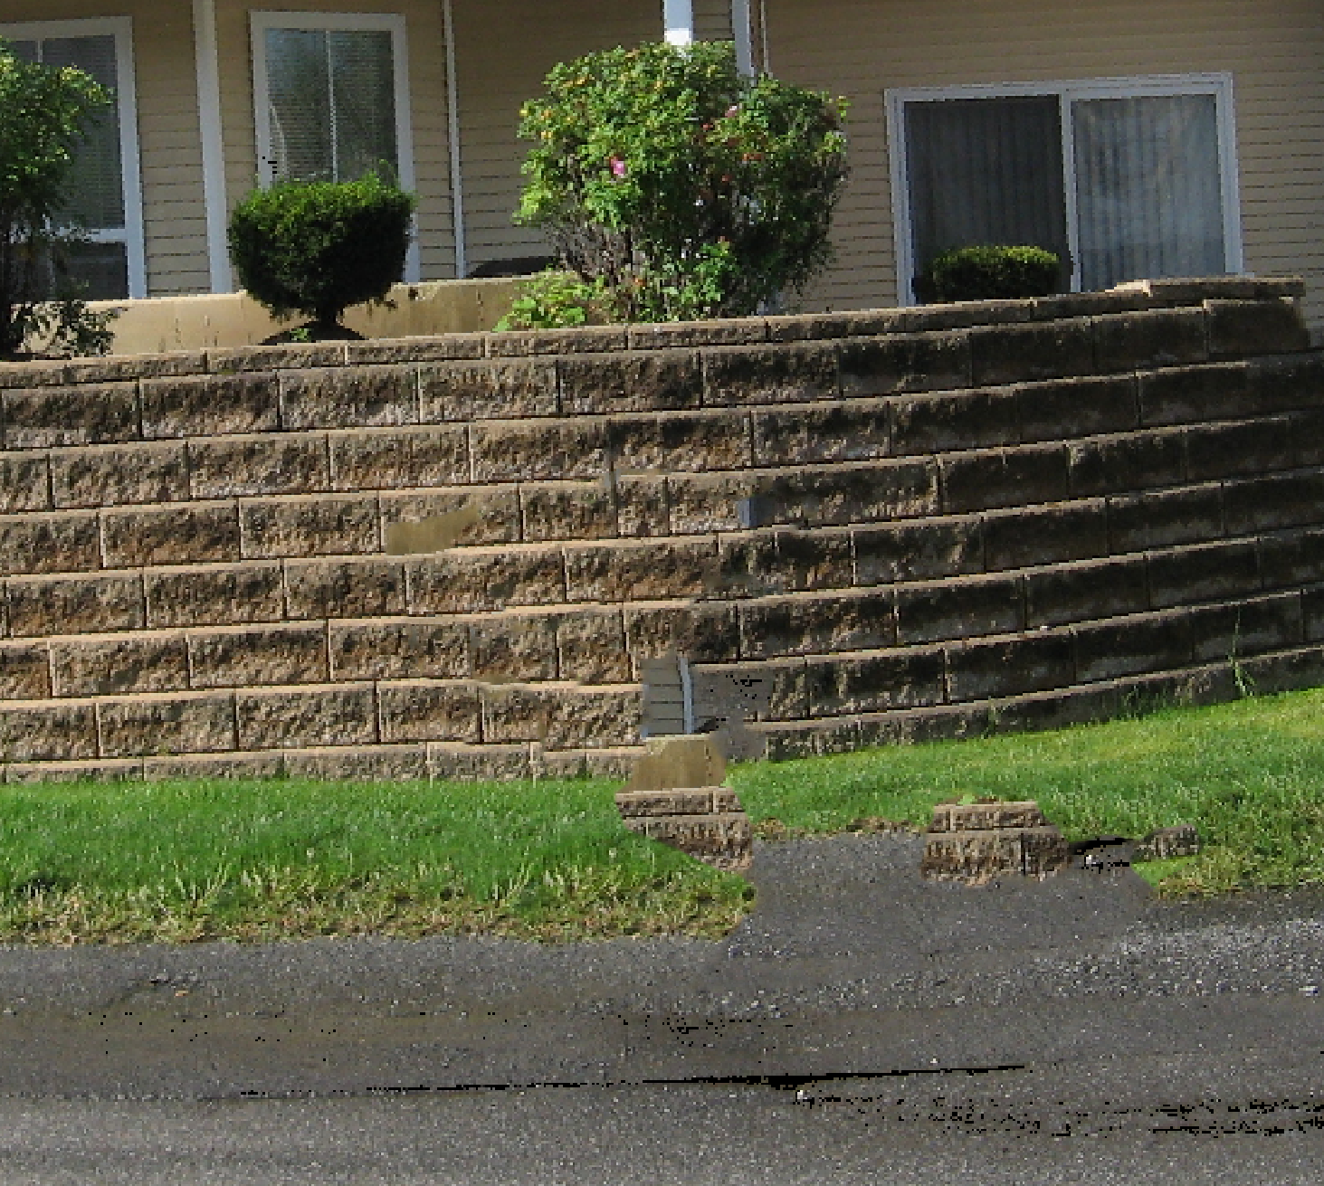
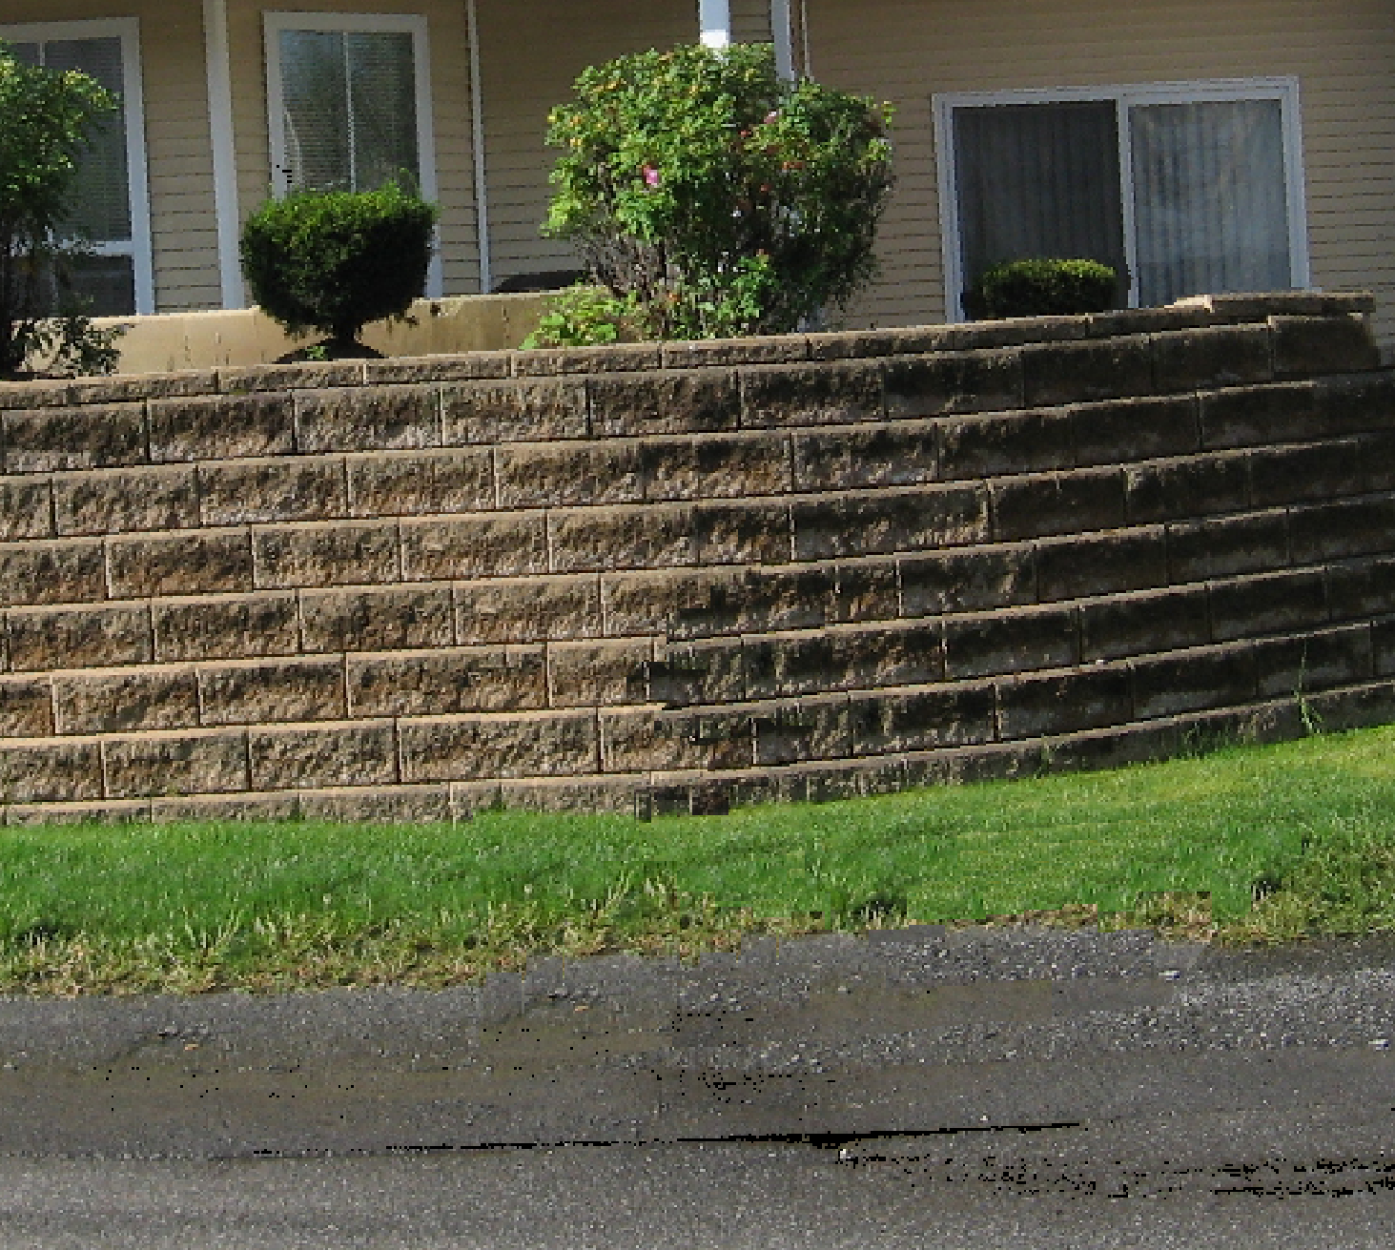
Thesis Contributions
Object Detection Verification
LiDAR Segmentation
LiDAR Hole Filling
Inpainting Improvements

Slide 3
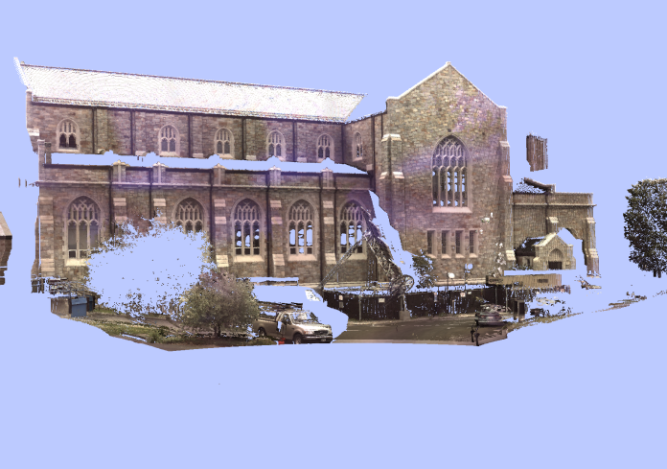
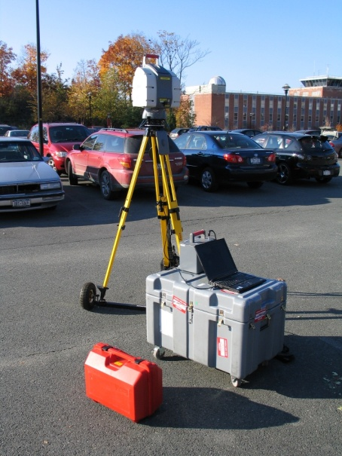
Light Detection And Ranging (LiDAR)
3D point acquisition
Long range
Very accurate
Notes:
Pulse lasers. Use time of flight calculations to determine the distance.

Slide 4
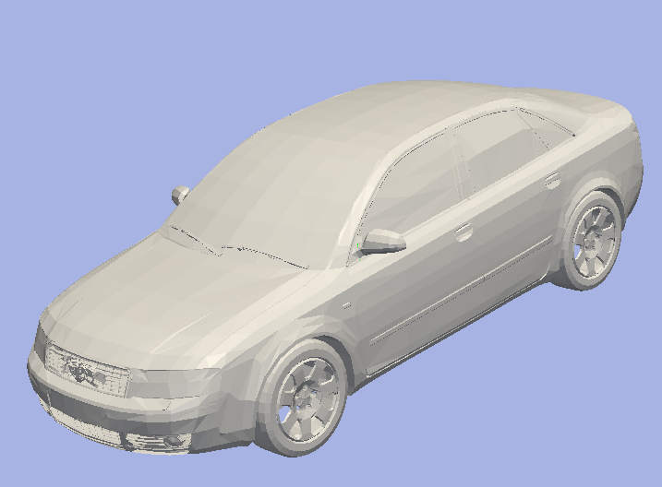
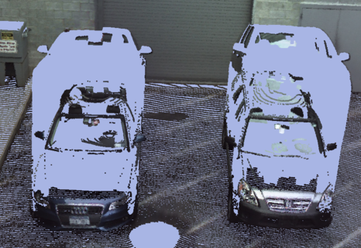
Contribution #1: Object Detection Verification
(Published in D. L. Doria and R. J. Radke. Consistency and Confidence : A Dual Metric for Verifying 3D Object Detections in Multiple LiDAR Scans. In International
Conference on 3-D Digital Imaging and Modeling, 2009.)
Model
Scan
Detected location
“How did we do?”
Notes:
Object detection problem – Given a mesh and a scan, determine where, if at all, the model exists in the scan.
Often have very massive data sets – want to automatically interpret results of object detection.

Slide 5
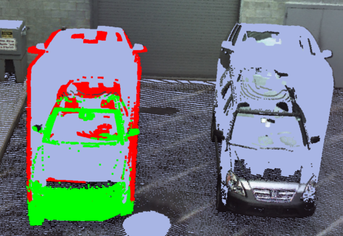
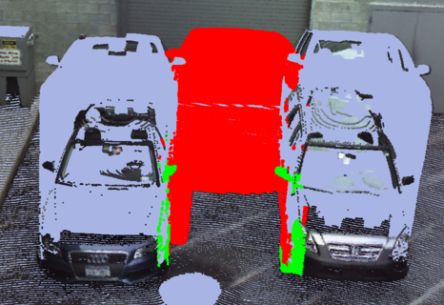
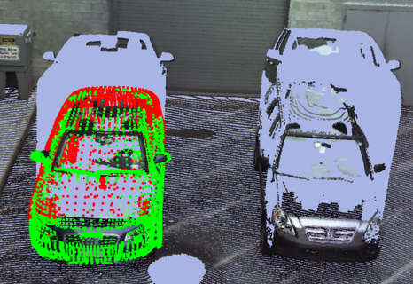
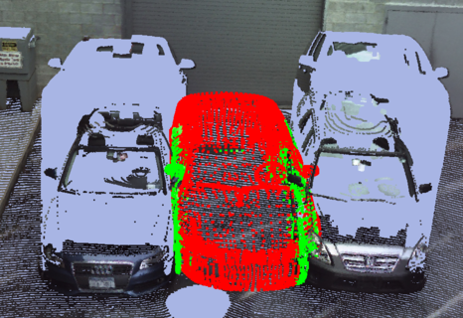
Experiment: Bad Detection Recognition
 |  | Correct | Incorrect
ICP Score | 0.057m² |  |  | 0.094m²
Consistency | 0.589 |  |  | 0.077
Confidence | 0.579 |  |  | 0.252

Slide 6
Contribution #2: LiDAR Object Segmentation
Under review D. L. Doria and R. J. Radke. LiDAR Data Manipulation: Object Segmentation and Hole Filling. Computer Vision and Image Understanding (CVIU)

Slide 7
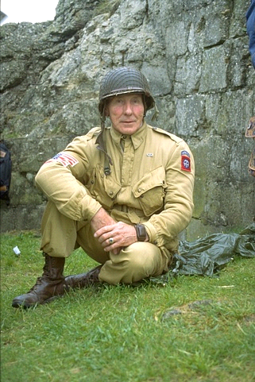
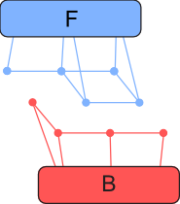
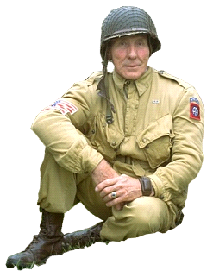
Graph-cut Based Image Segmentation
Notes:
A cut is collection of edges that if removed, the terminals are separated.

Slide 8
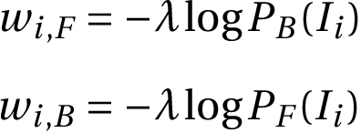
Edge Weights
Inter-node weights: difference between pixel values
Node-Terminal weights: priori probability
Notes:
High weight when pixels are similar because the edge should be hard to cut.

Slide 9
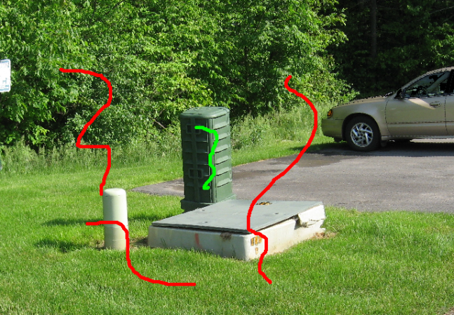
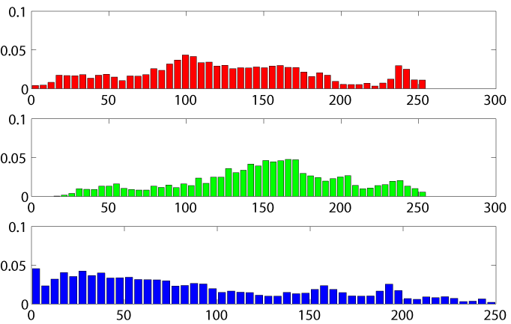
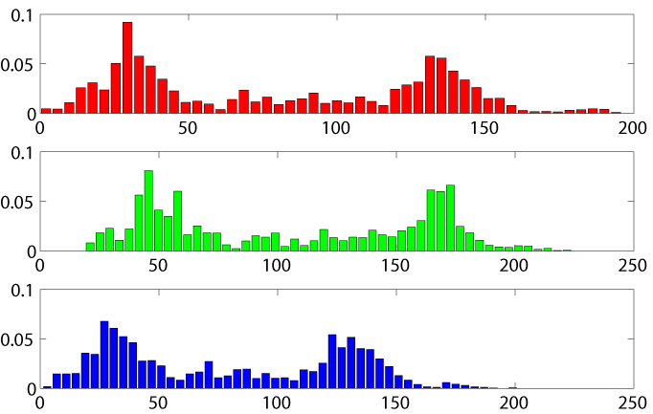
Scribbling
Background
Foreground

Slide 10
Extension to LiDAR Segmentation

Slide 11
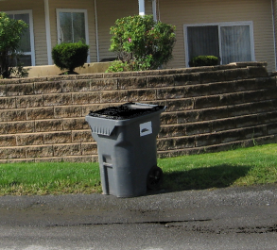
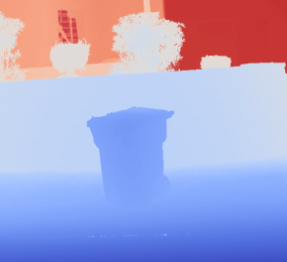
Direct Extension of Image Segmentation
Represent the LiDAR data as a 4-channel image L (RGBD)
Modifications to the graph
Difference function between pixels includes the depth information
4D histograms to compute terminal edge weights
=
+

Slide 12
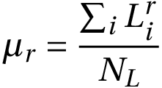
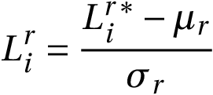
Normalizing Image Channels
Assumed R, G and B channels contribute equally, but depth channel values are very different
Weighted difference function
Normalize the channels
Notes:
(meters, typically [5,30]) from the RGB channels (arbitrary units [0,255])

Slide 13
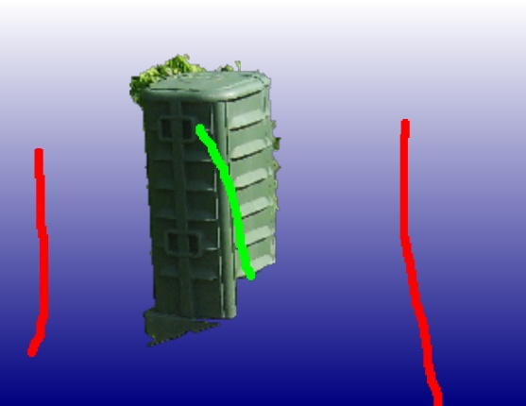
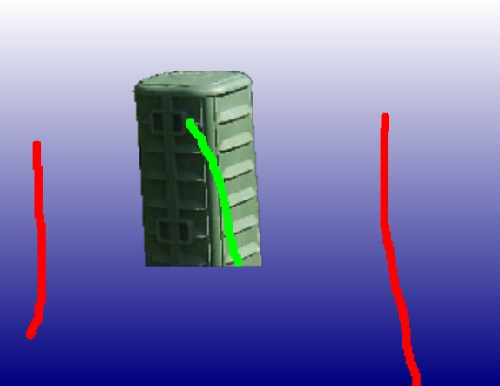
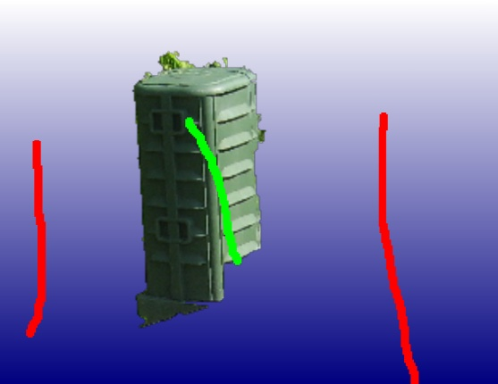
Poor Results!
Color only
Depth only
Equal weights
Manual weight tweaking

Slide 14
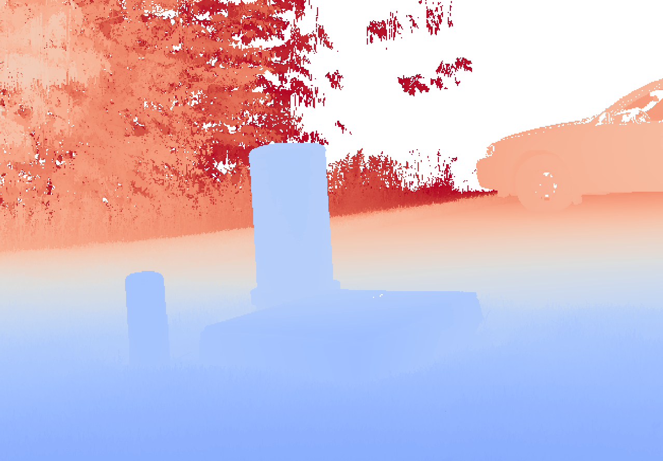
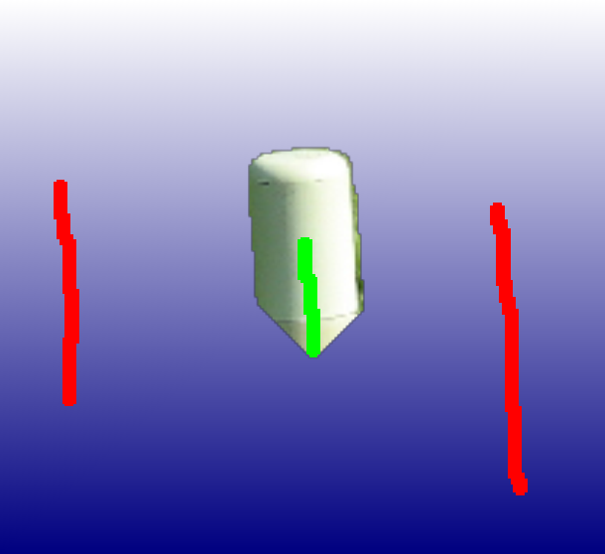
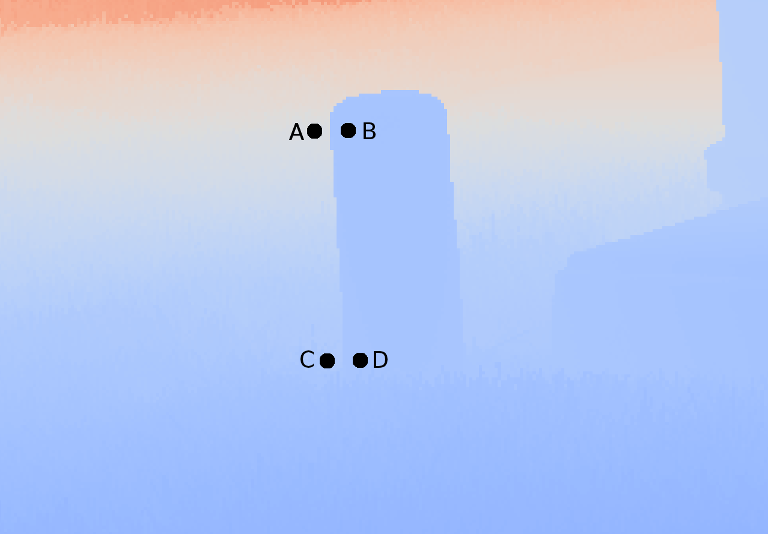
Behavior of Depth-Only Segmentation
Notes:
Near the ground-attachment, the differences in pixels across the object boundary are not strong enough to make the cost of the cut that follows these edges cheaper than the cost of the cut that is more direct (shorter path).

Slide 15
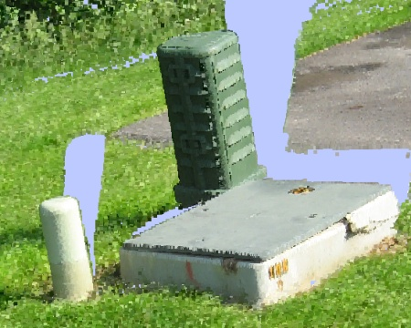
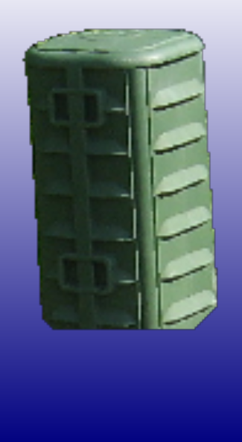
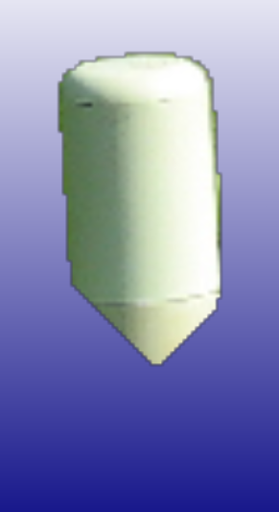
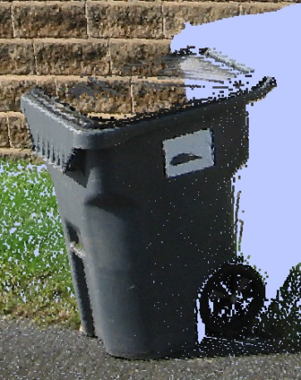
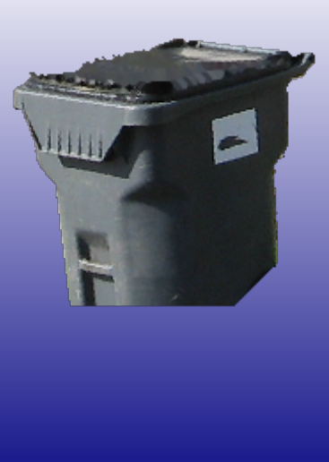
Realization - Undersegmentation

Slide 16
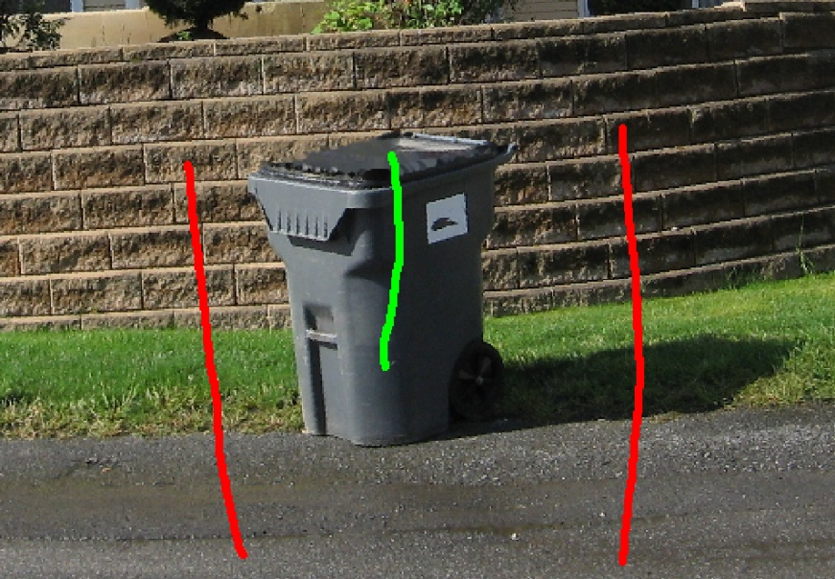
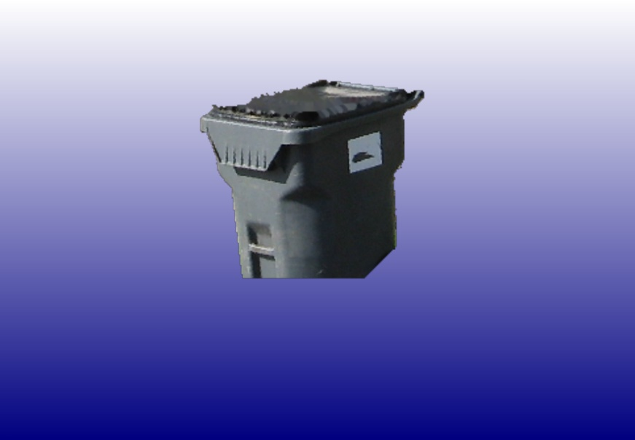
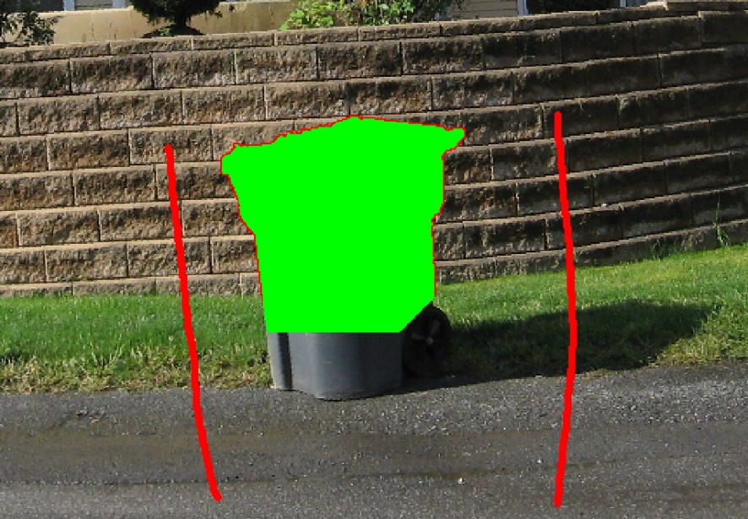
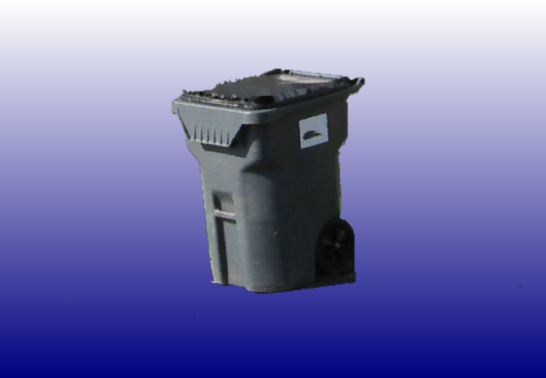
Two-step segmentation

Slide 17
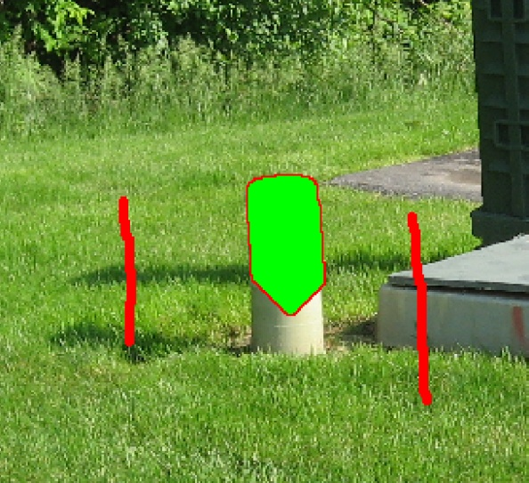
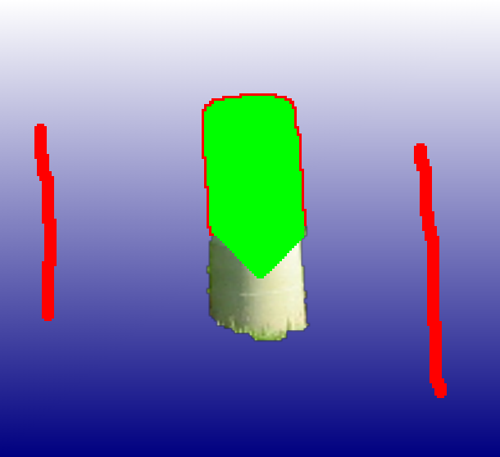
New Background Pixel Determination

Slide 18
Recorded Segmentation Session

Slide 19
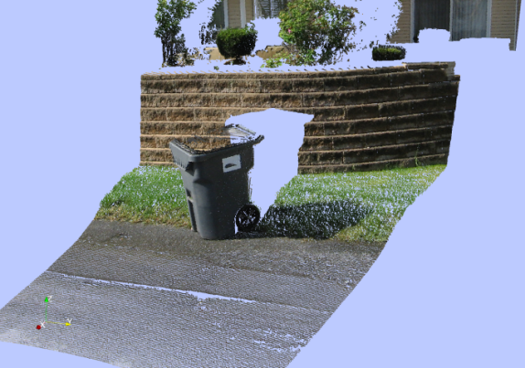
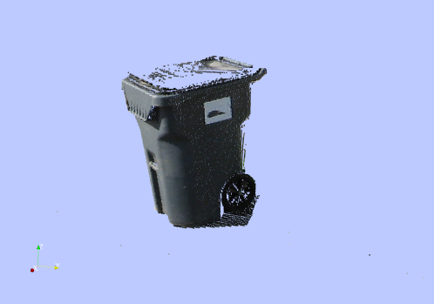
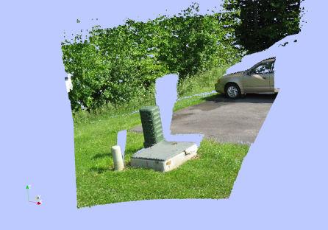
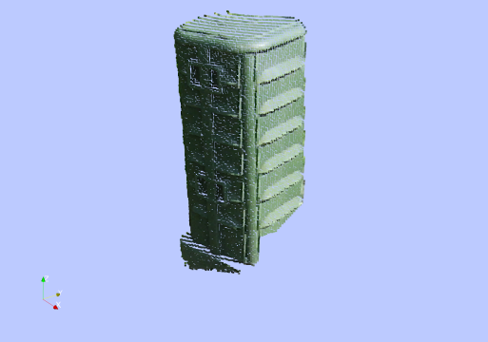
Results

Slide 20
Contribution #2 Recap
Construct RGBD image from LiDAR data
Exploit undersegmentation of depth image
Two-step LiDAR segmentation
Works well on real world scans

Slide 21
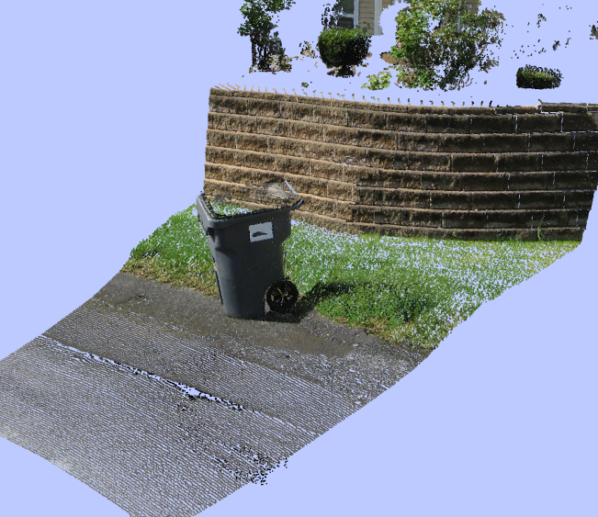
Contribution #3: LiDAR Hole Filling
Published in D. L. Doria and R. J. Radke. Filling Large Holes in LiDAR Data By Inpainting Depth Gradients. In International Workshop on Point Cloud Processing, 2012.
D. L. Doria and R. J. Radke. LiDAR Data Manipulation: Object Segmentation and Hole Filling. Under review in Computer Vision and Image Understanding (CVIU)
Notes:
In this section, we are interested in reconstruction plausible colors and depths inside the hole.

Slide 22
LiDAR Shadows
Notes:
We are going to use techniques from image inpainting and gradient-based reconstruction to fill in this hole.

Slide 23
Image Inpainting
Popularized in Criminisi CVPR 2003

Slide 24
?

Slide 25
Example Patch-Based Inpainting

Slide 26
Extension to LiDAR Inpainting

Slide 27
Image Reconstruction From Gradients
G_{x}
G_{y}

Slide 28
Image Reconstruction From Gradients
(Pérez et al. ToG 2003)
Minimize the difference between the reconstructed image’s gradients and the provided gradients
From variational calculus (Euler-Lagrange equation), the solution is the function
Notes:
Using Euler-Lagrange equation, the function which minimizes this functional is as follows.

Slide 29
LiDAR Inpainting
Assemble result
Reconstruct depth
Construct RGBD_{x}D_{y}
image
Inpaint the RGBD_{x}D_{y}
image
Boundary condition

Slide 30
LiDAR Inpainting Animation

Slide 31
Experiments

Slide 32
Contribution #3 Recap
Fill large holes in LiDAR scans
Inpaint RGBD_{x}D_{y} image
Reconstruct depth image from completed D_{x}D_{y} channels
Successful completions on several real world scans

Slide 33
Contribution #4: Patch-Based Inpainting Improvements
D. L. Doria and R. J. Radke. Improving Inpainting by Preventing Bad Patches. Under review, Computer Vision and Pattern Recognition, 2013
Notes:
Make images bigger

Slide 34
Effect of a Single Bad Patch

Slide 35
Bad Match Analysis: Statistical Fluctuation
Target Patch
Best SSD Patch
(SSD=7101)
Better Patch
(SSD=8710)
Notes:
Stop ppt from blurring?

Slide 36
Bad Matches Due to Smoothness
Target Patch
Best SSD Match
(SSD=2964)
Better Patch
(SSD=5464)
Average Value of Target Patch!

Slide 37
Texture – Gradient Magnitude Histograms
Query Patch
Bad Source Patch
(Best according to SSD)
Better Source Patch

Slide 38
Top 100 Patches (SSD)
Target Patch

Slide 39
Top 100 Patches Sorted by GMH
Target Patch

Slide 40
Typical Inpainting Algorithm

Slide 41
Improved Automatic Algorithm

Slide 42
Interactive Algorithm

Slide 43
User Interaction

Slide 49
Contribution #4 Recap
Bad patches can wreak havoc
Prevent bad patches using GMH
Interactively correct bad patches
Significantly improves results

Slide 50
Future Work
Speed up consistency/confidence enough to use for object detection
Automatically register LiDAR and image data
LiDAR segmentation with registered data from multiple views
GUI to work in multiple 2D views instead of 3D
Challenging inpainting problems
Notes:
Challenging data sets. Perceptual organization can be used.

Slide 51
Future Work

Slide 52
Publications To Date
D. L. Doria and R. J. Radke. Consistency and Confidence: A Dual Metric for Verifying 3D Object Detections in Multiple LiDAR Scans. In International Conference on 3-D Digital Imaging and Modeling, pages 1481–1488, 2009.
D. L. Doria and R. J. Radke. Filling Large Holes in LiDAR Data By Inpainting Depth Gradients. In International Workshop on Point Cloud Processing, 2012.
D. L. Doria and R. J. Radke. LiDAR Data Manipulation: Segmentation and Hole Filling. Under review in Computer Vision and Image Understanding.
D. L. Doria and R. J. Radke. Improving Inpainting by Preventing Bad Patches. Under review in Computer Vision and Pattern Recognition, 2013.
Several technical reports in the Insight Journal, Visualization Toolkit Journal, and Kitware Source Magazine

Slide 53
Thesis Summary
Object Detection Verification
LiDAR Segmentation
LiDAR Hole Filling
Inpainting Improvements
Notes:
Stop on this slide!

