Slide 1
LiDAR Segmentation and Hole Filling
David Doria

Slide 2
Motivation
Image editing has become so common place that “Photoshopping” has become a verb
Currently editing 3D data is very labor intensive
We want to edit LiDAR scan as we can images – a “Photoshop” for LiDAR

Slide 3
The Goal
Main goals:
Seamlessly delete an object from a scene
Move an object in a scene
Two parts:
Selecting the object to remove
Filling in the hole left by the object (LiDAR shadow)

Slide 4
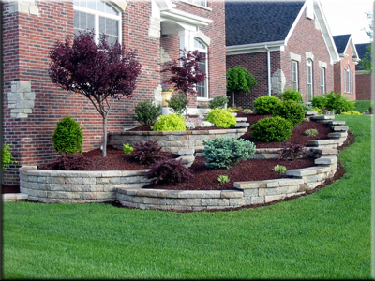
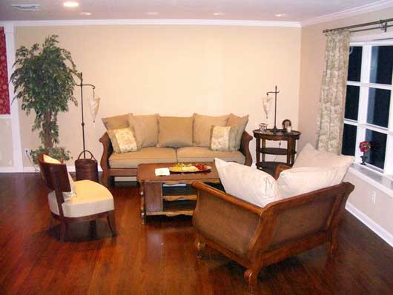
Application
Interior design/remodeling
“What would this couch look like in my room?”
“How should I rearrange my furniture?”
Landscaping
Place/move trees and bushes
Architecture
Layout from aerial scans
“What would it look like if we tore down this building?”
Data viewing enhancement
LiDAR shadow problem
http://www.genevalandscape.com/wp-content/uploads/2010/05/landscaping.jpg
http://i810.photobucket.com/albums/zz25/homezooka/feng%20shui/beige_living_room_01.jpg

Slide 5
Step 1 - Selecting objects
Minimize user interaction
User interaction is still much easier in 2D (mouse)
No prior information (shape database) – very hard to collect and hand segment
Draw on existing image segmentation techniques

Slide 6
Image Selection User Interface

Slide 7
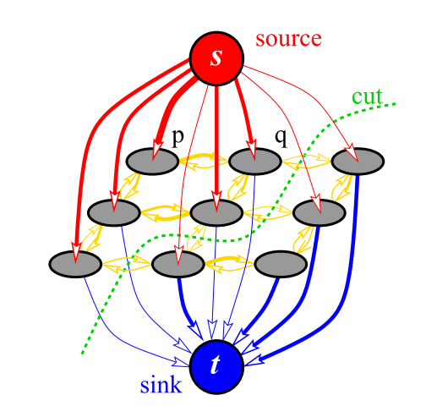
Graph cut image segmentation
Create a node in a graph for each pixel
Join 4-connected pixels with edges
Create an imaginary source and sink terminal
Join all nodes to both terminals
Weight edges between nodes based on their color difference
Weight edges between source/sink terminal based on histogram of user specified pixels (scribble)
(taken from “An experimental comparison of min-cut/max-flow algorithms for energy minimization in vision)

Slide 8
Graph cut theory
The “best” segmentation minimizes:
$$E\left(S\right)= λR\left(S\right)+B(S)$$
Region term: how well does the segmentation agree with the histograms computed from the user specified strokes?
Boundary term: how dissimilar are pixels over the segmentation boundary?

Slide 9
Depth image segmentation
The problem of LiDAR segmentation is actually easier as depth discontinuities are a very good indication of object boundaries
Treat the depth as a 4th channel (RGBD) and perform the same graph cut
Stokes still specified in 2D
Weights of the image channels are tricky (could learn them from training data)

Slide 10
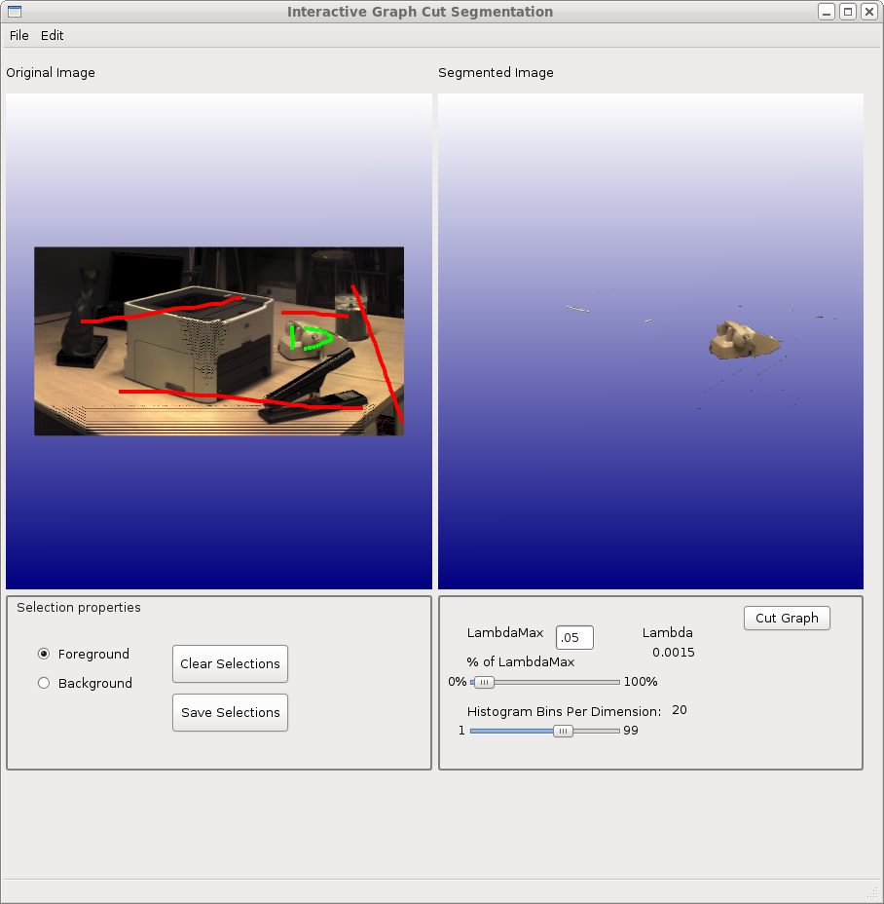
LiDAR Selection User Interface (Identical!)

Slide 11
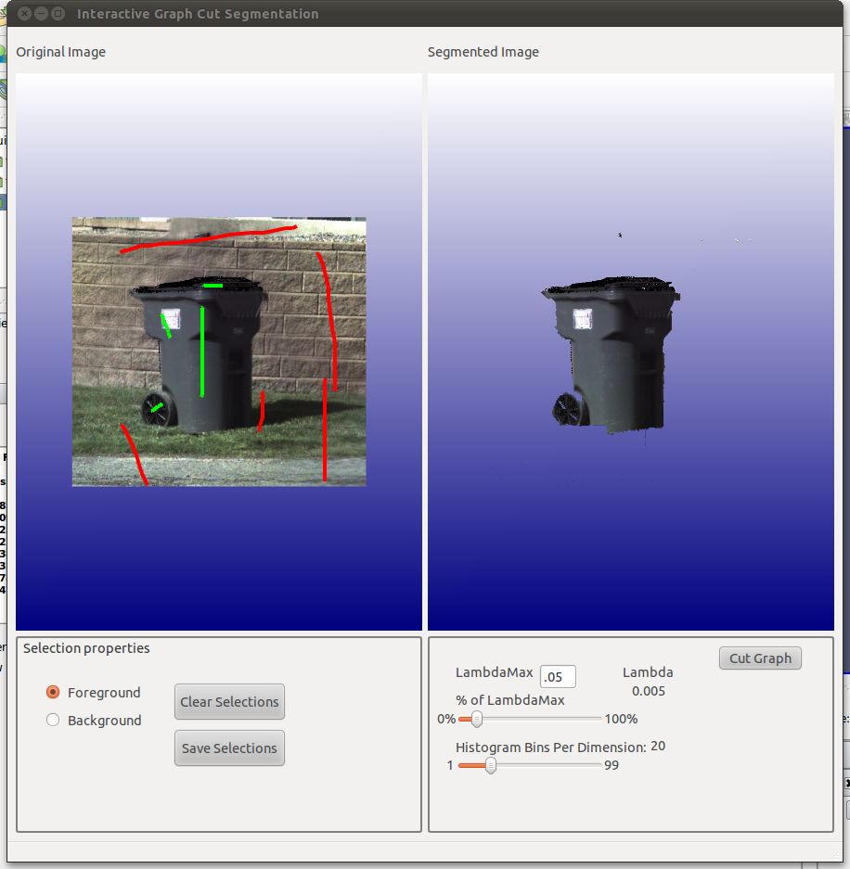
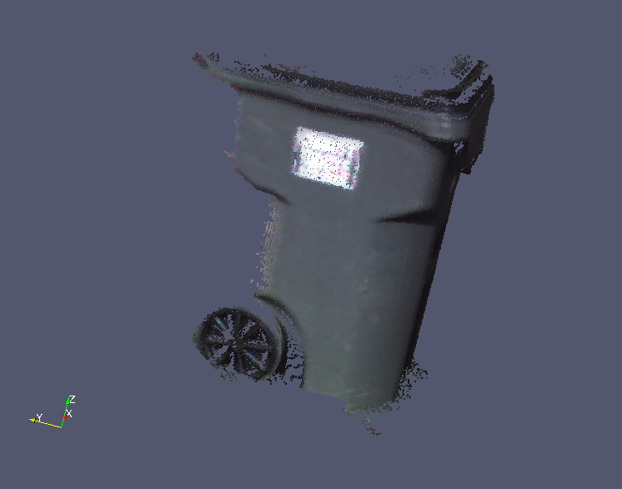
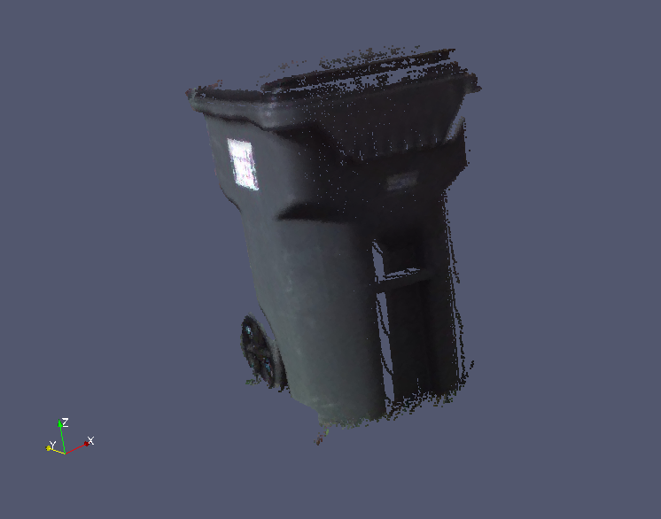
Segmented LiDAR
Resulting pointcloud (2 views to show 3D nature)

Slide 12
Hole filling goals
Minimize user interaction
Again, working in 2D is easier than 3D
Draw on existing image completion techniques

Slide 13
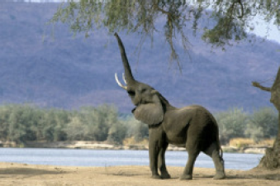
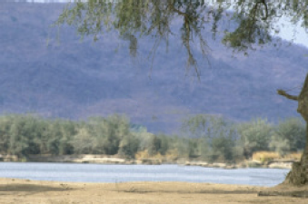
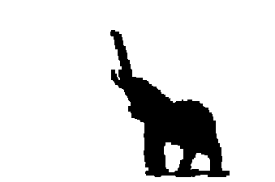
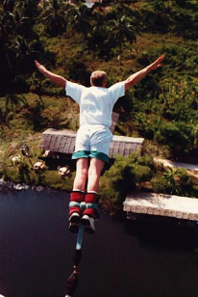
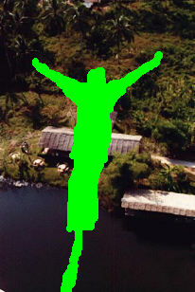
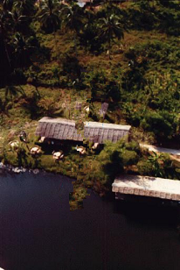
Image completion
Given an image with a hole, produce a plausible looking complete image
There is no “right answer”
Input
Mask
Output

Slide 14
Image completion details
Many methods (inpainting) attempt to “blur/bleed” information from outside the hole into the hole
Works great for small, thin holes
Very blurry for large holes
Other methods (image completion/texture synthesis) attempt to fill in the missing region using known image patches
Two main advances in the last 10 years
Greedy patch-based completion (Criminisi)
Globally optimal patch-based completion (Komodakis)

Slide 15
Greedy completion (Criminisi)
Determine the “best” patch to fill
Based on isophotes (direction of linear structures)
Want to favor continuing linear structures
Copy the best patch (based on how well it matches the overlapping source region
Repeat until the hole is filled
(Taken from “Region Filling and Object Removal by Exemplar-Based Image Inpainting”)

Slide 16
Greedy completion (cont.)
For simple scenes, works well
Very fast
For complex scenes, very poor results
No “going back” – if you get a single patch “wrong” the rest of the result is very poor

Slide 17
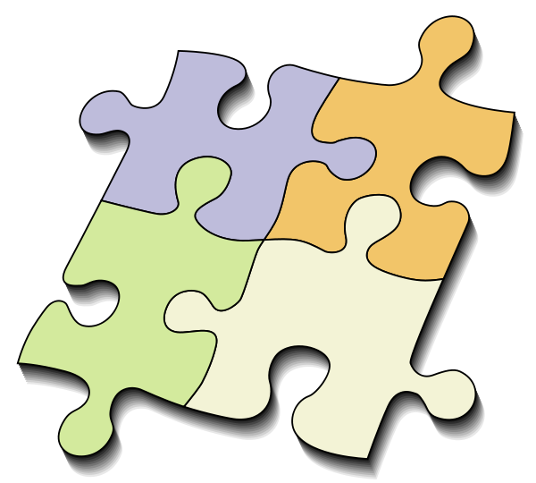
Globally optimal completion
Solving a jigsaw puzzle
Massive multi-label graph optimization problem
Belief Propagation too slow -> Priority Belief Propagation

Slide 18
Global completion
(Taken from “Image Completion Using Global Optimization”)
$$U_{i}=\sum_{s=source region}{{(I\left(s\right)−P\left(s\right))}^{2} }$$
Single (unary)node potential
Binary node potential
$$B_{i}=\sum_{s=overlap region}{{(P_{1}\left(s\right)−P_{2}\left(s\right))}^{2} }$$
Best solution
Min($\sum_{All patches}{U_{i}+B_{i} })$

Slide 19
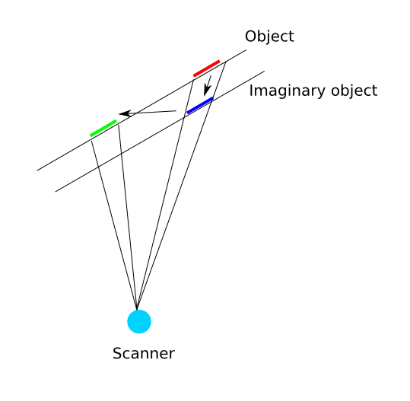
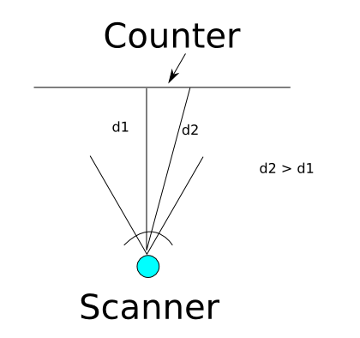
Filling depth images naively
Our RGBD method worked great for segmentation, why not completion too?
Patches with the depths you need do not exist

Slide 20
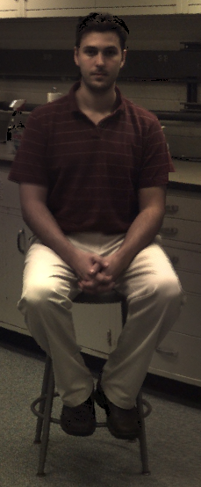
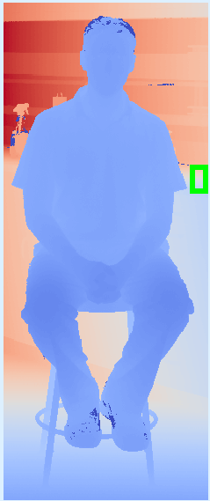
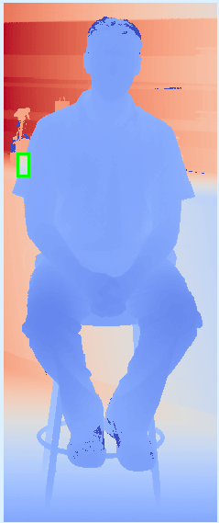
Naïve depth completion
The right side of the counter “looks” exactly like the left side, but absolute depths are wrong!

Slide 21
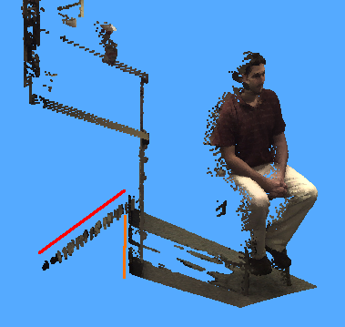
Naïve depth completion demo

Slide 22
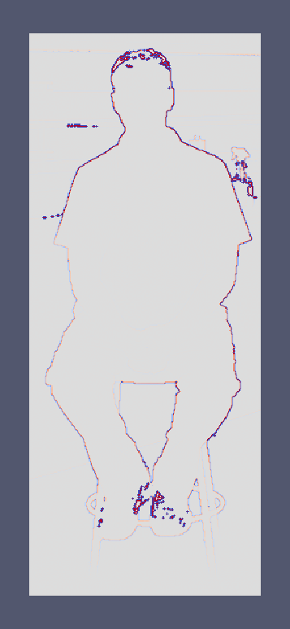
Use structure rather than depth
We want patches that “look the same” to be good matches, even if they come from different depths in the scene
Use the Laplacian of the depth image to do the completion

Slide 23
Depth Laplacian -> Depth
Conveniently, we have exactly what we need to do a Poisson reconstruction (Dirchlet boundary condition is the depths of the hole boundary)
Completing the Laplacian of depth image followed by a Poisson reconstruction produces the result we wanted to achieve by completing the depth image directly

Slide 24
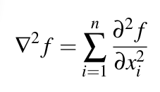
Poisson reconstruction
Compute the Laplacian
Solve the Laplace equation to find the “smoothest” hole filling
Solve the Poisson equation to compute the “smoothest” source/target blending

Slide 25
After copying Laplacian patches, return to depth domain

Slide 26
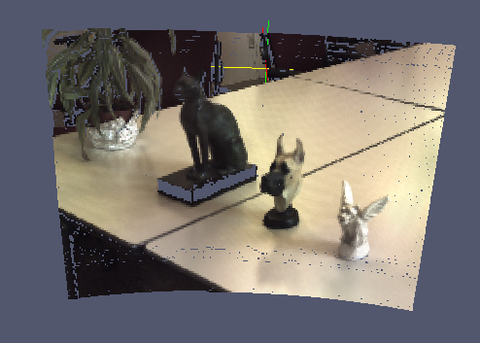
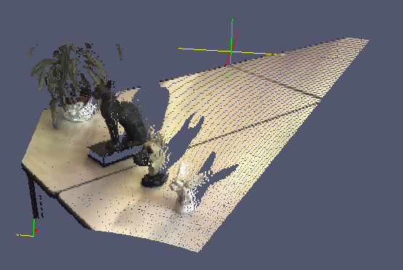
Demonstration – Statues on desk
View from scanner
View showing shadows
Object removed and hole filled

Slide 27
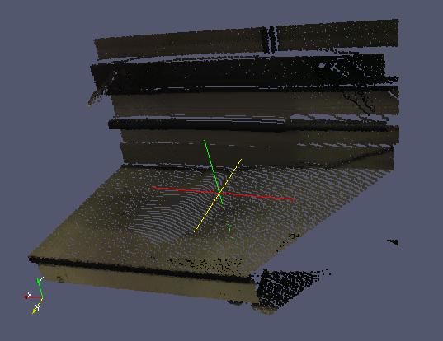
Demonstration – Monitor on desk
Notice that the corner between the wall and the counter, along with the pipe, are successfully completed. This would not be possible with inpainting in the depth image.

Slide 28
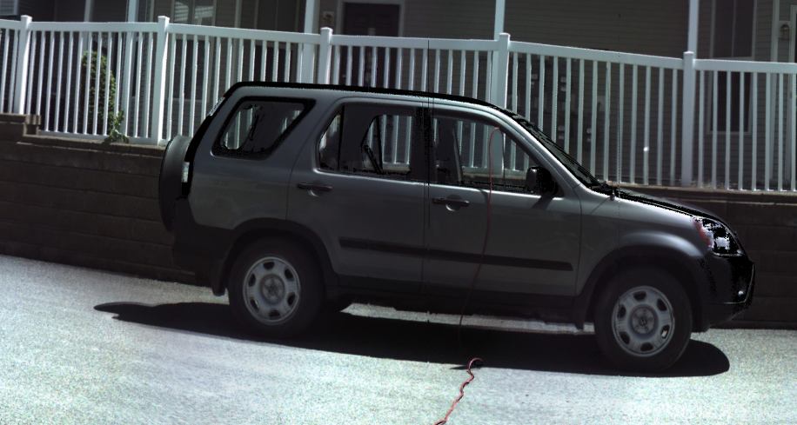
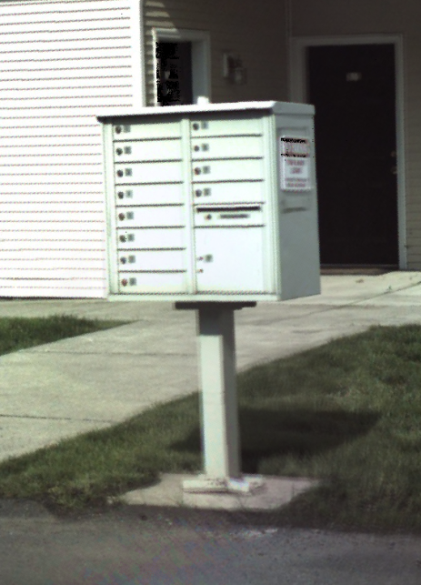
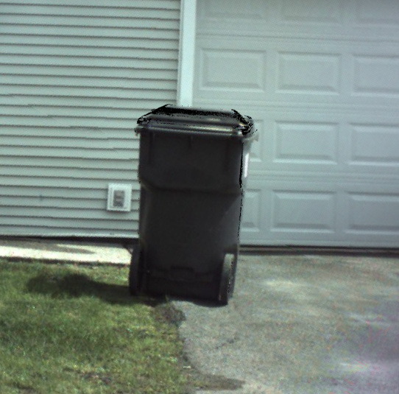
Future work
Complicated background texture
Cases with no “end” to connect to the “beginning” of a linear structure

