Slide 1

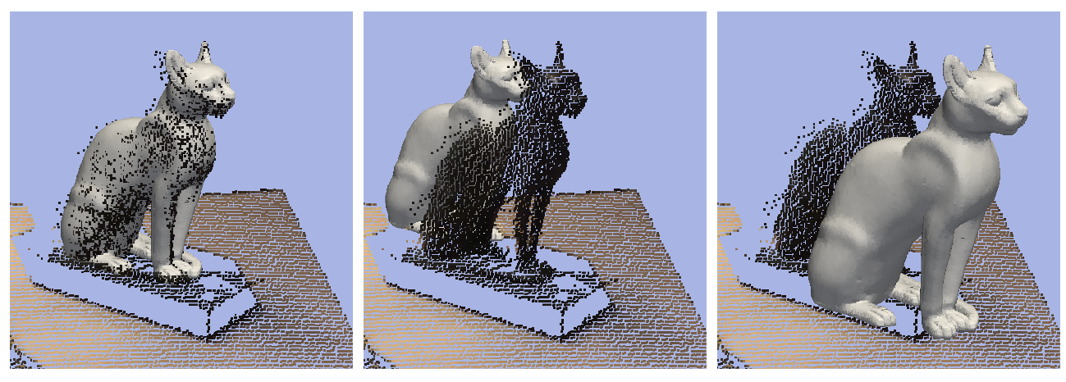
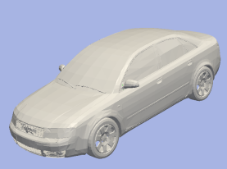
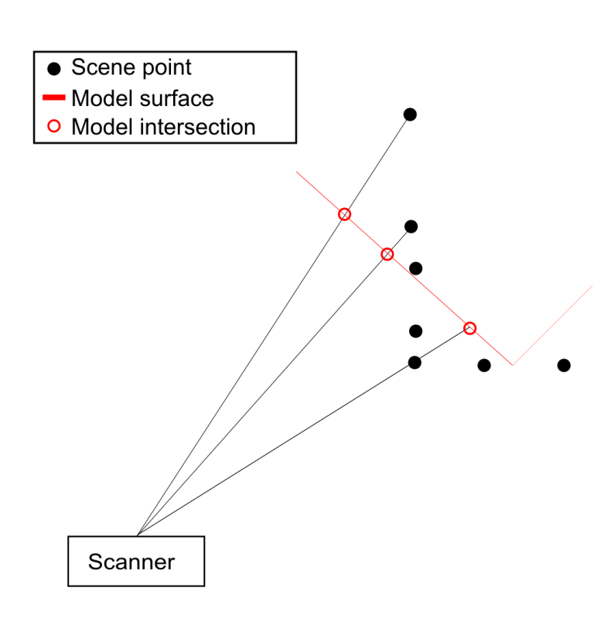
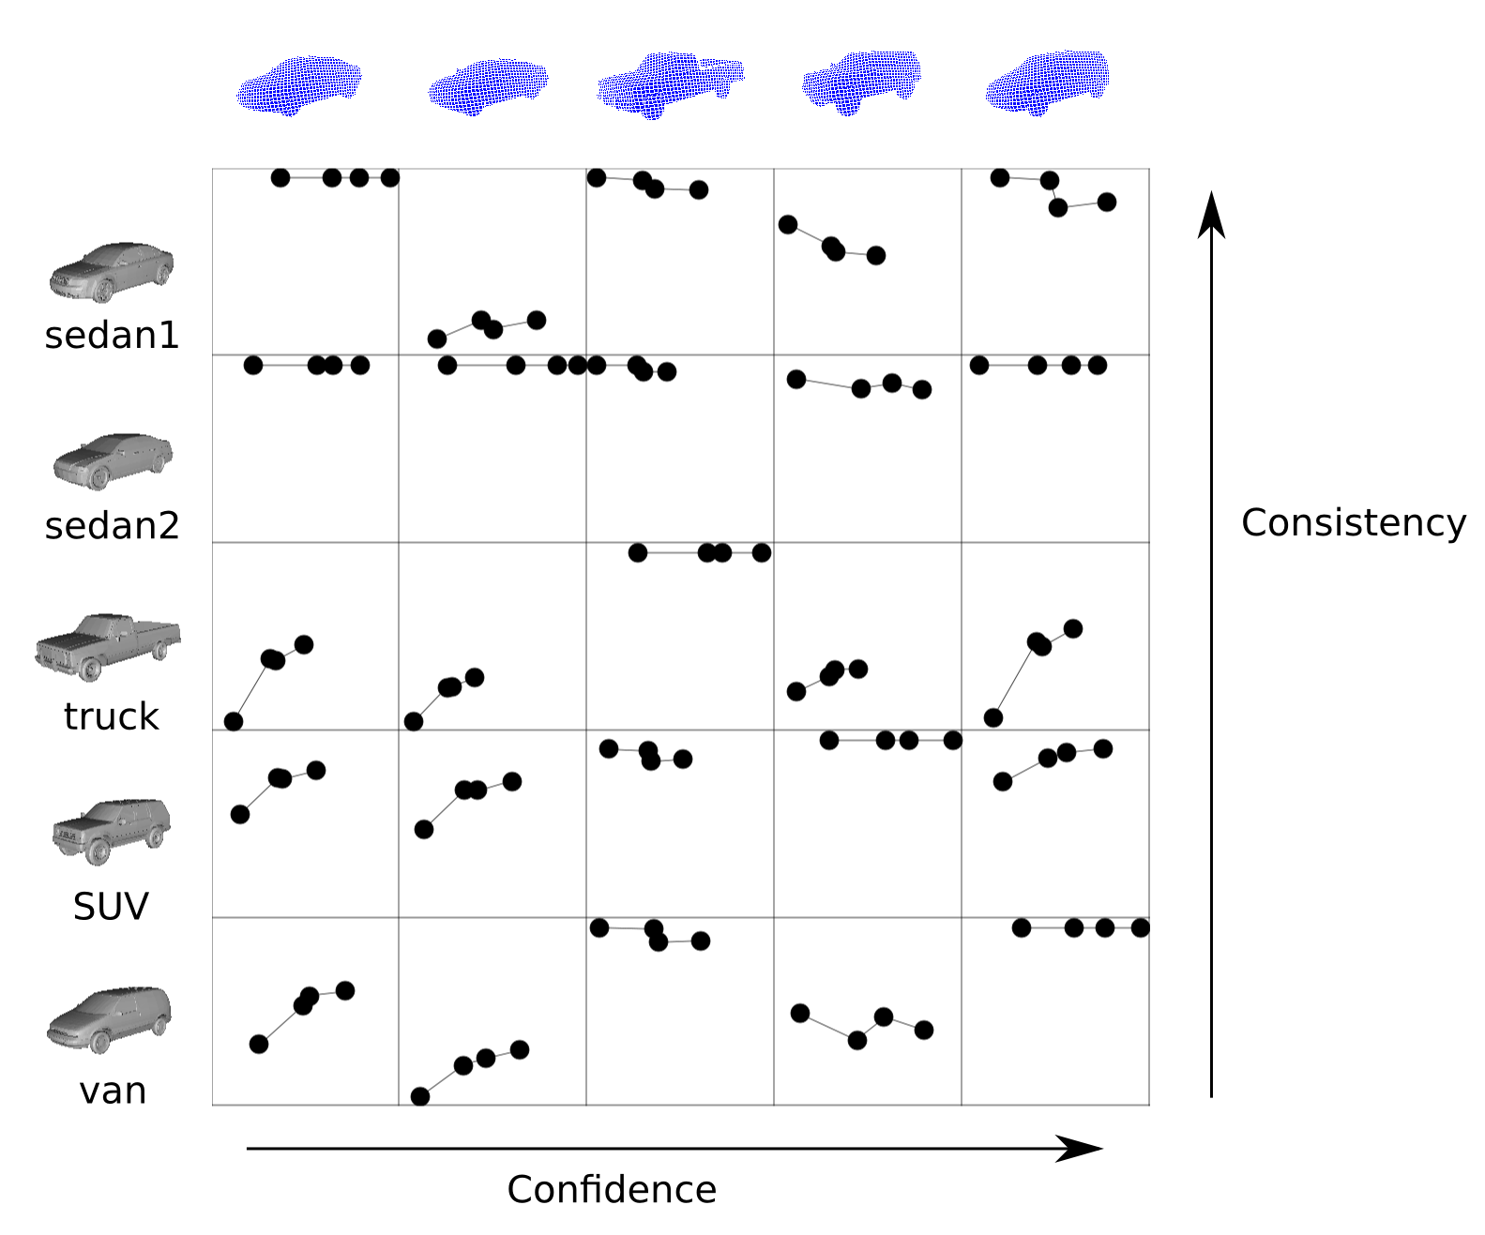
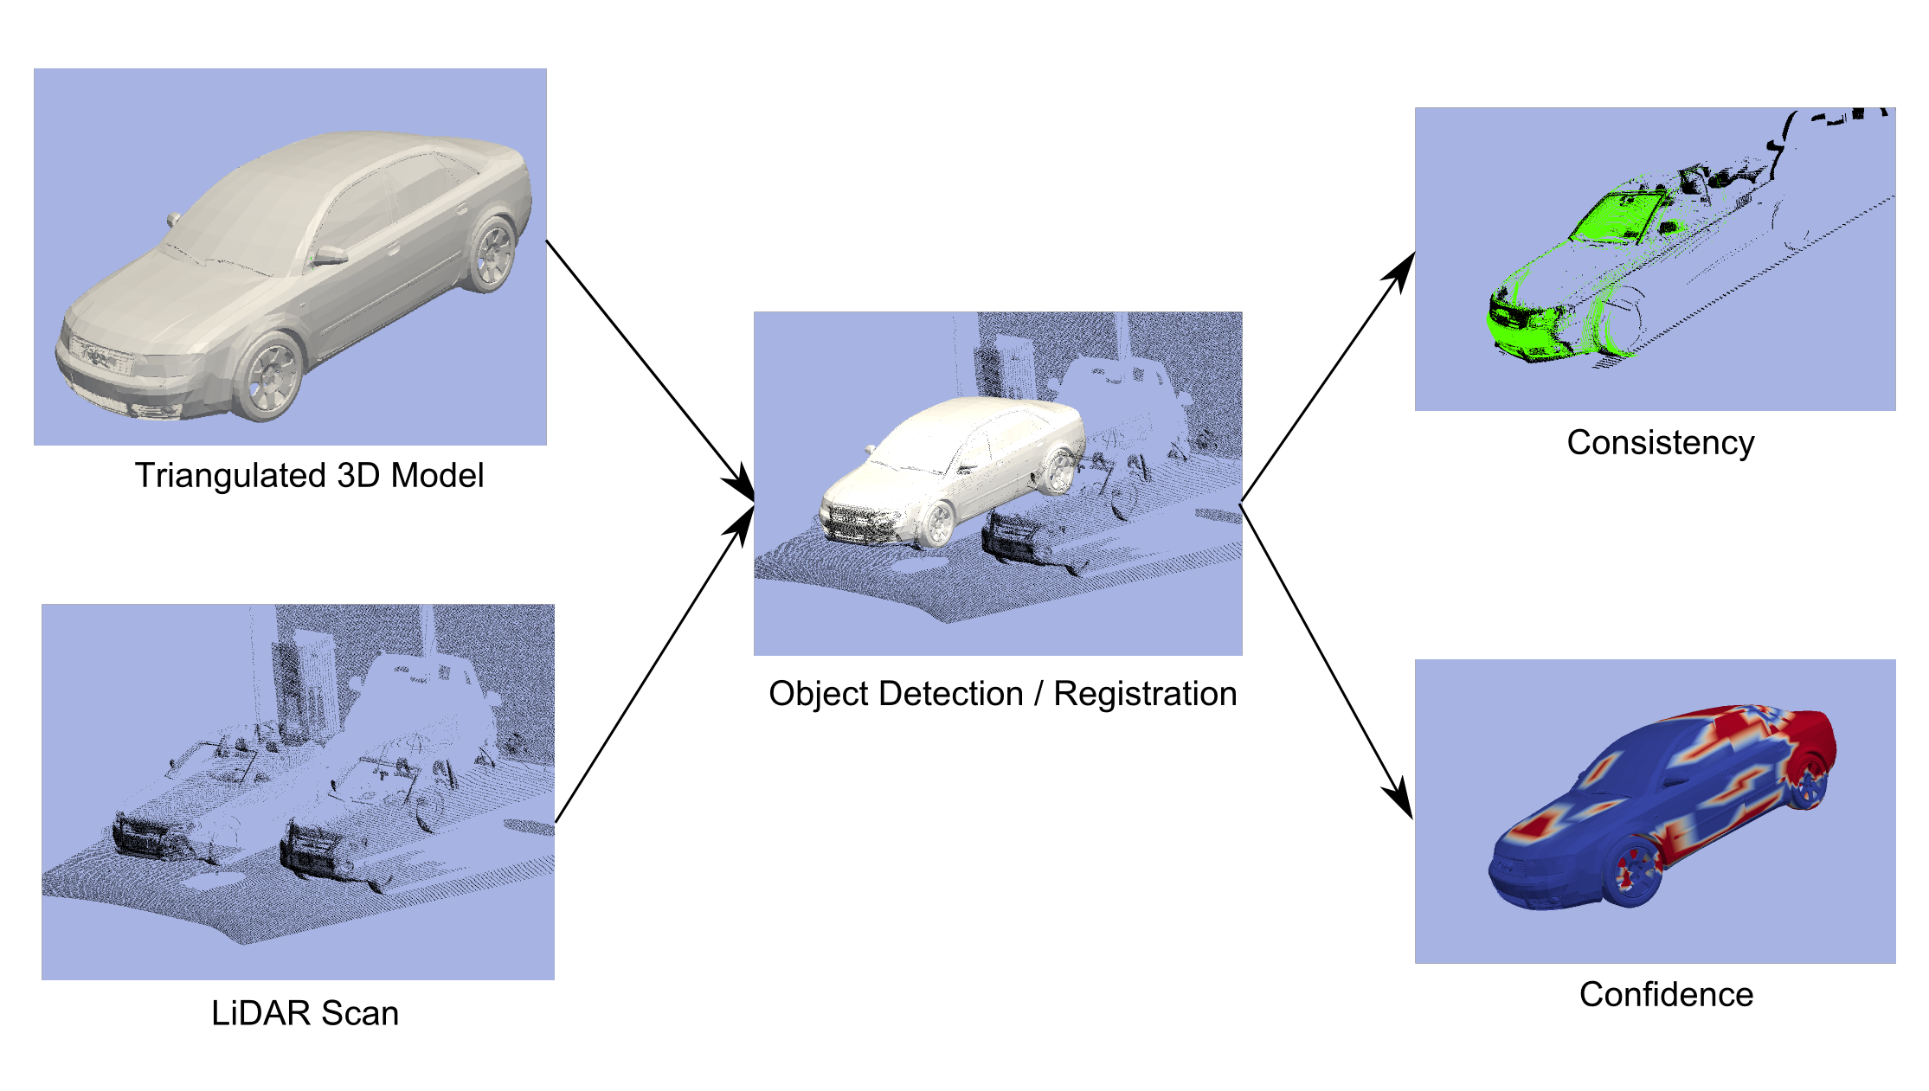
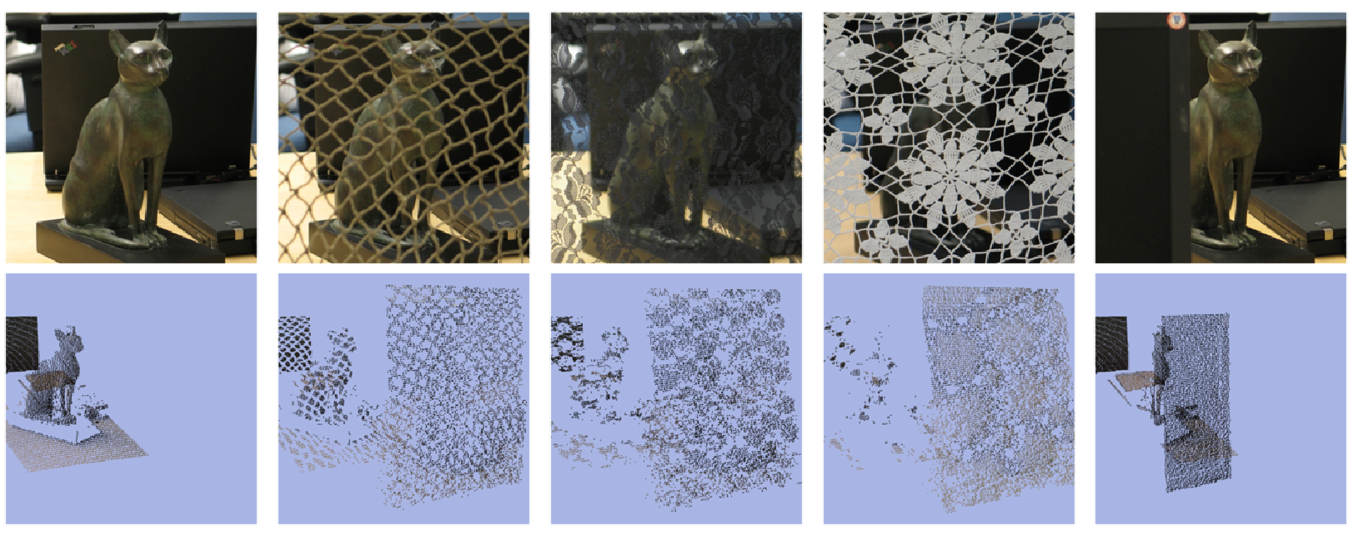
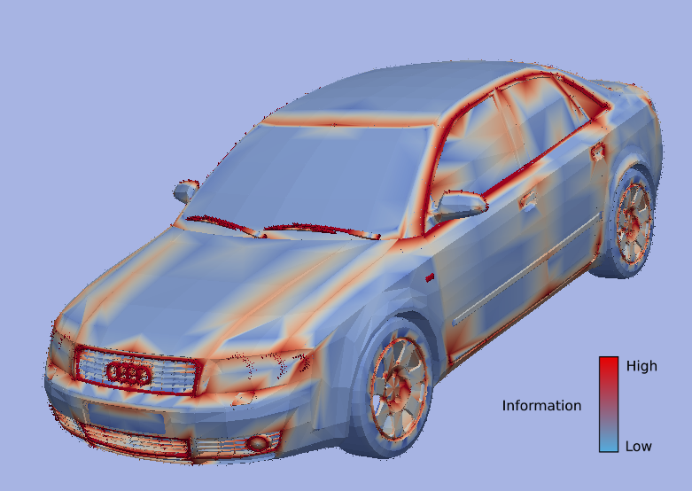
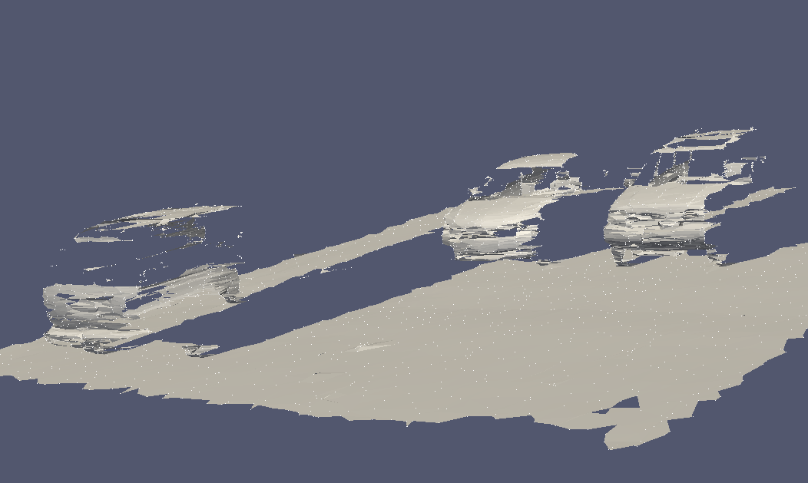
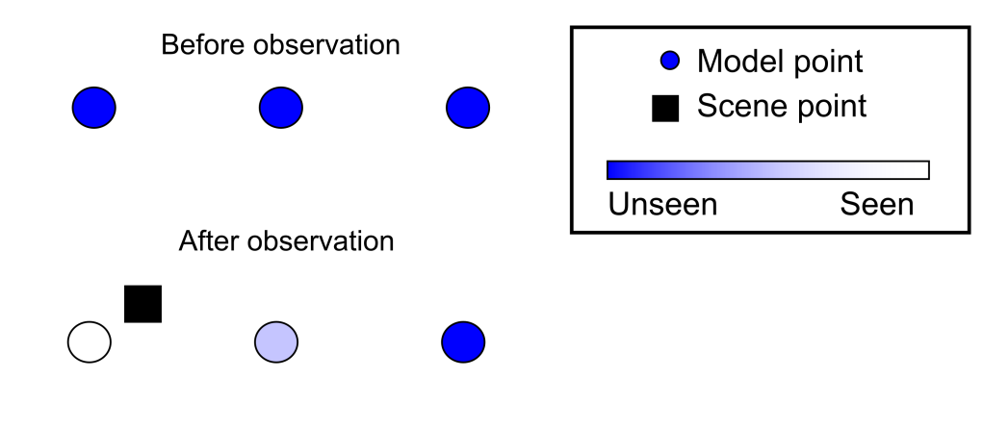
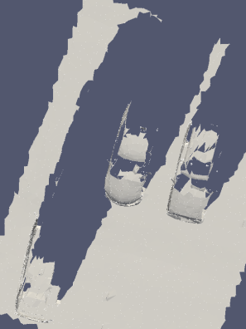
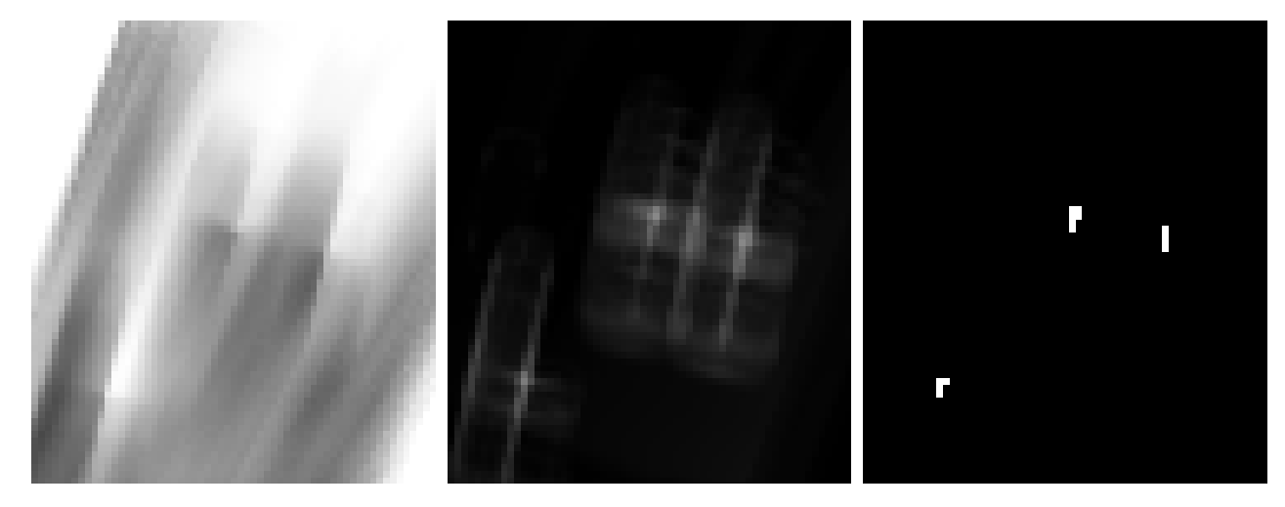
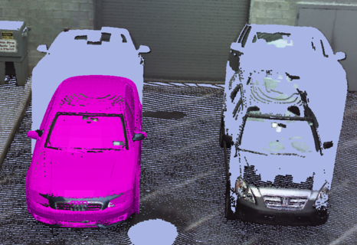
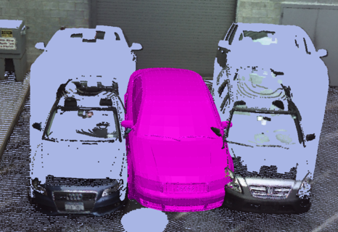
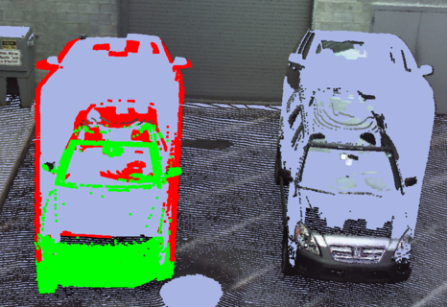
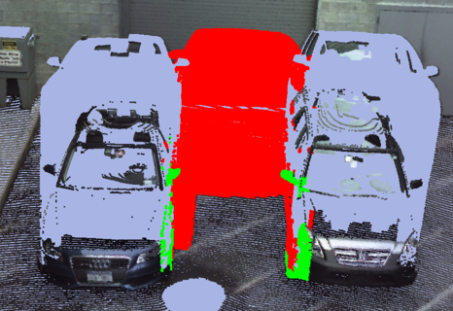
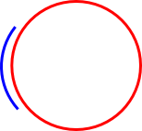
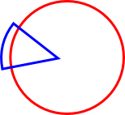
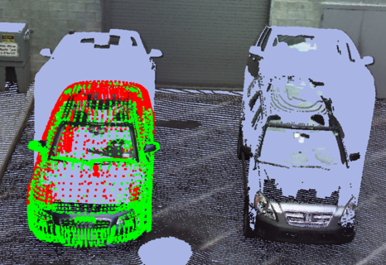
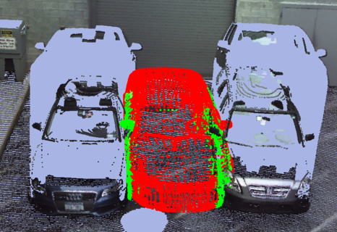
Consistency and Confidence: A Dual Metric for Verifying 3D
Object Detections in Multiple LiDAR Scans
David L. Doria¹ and Richard J. Radke²
Rensselaer Polytechnic Institute, Department of Electrical, Computer, and Systems Engineering
Goals
The Consistency Measure
Cat Sculpture Demonstrations
Effects of Multiple Scans
We introduce a dual, physically meaningful metric for verifying whether a 3D model occupies a hypothesized location in LiDAR scans of a real world scene. We propose two complementary measures: consistency and confidence. The consistency measure uses a free space model along each scanner ray to determine whether the observations are consistent with the hypothesized model location. The confidence measure collects information from the model vertices to determine how much of the model was visible. The metrics do not require training data and are more easily interpretable to a user than typical registration objective function values.
“If the model was present, could we have seen this point?”
Scan 4
Scan 3
Four synthetic scans of five automobile models were performed. The cumulative consistency and confidence were computed for each pair, revealing intuitive similarities and differences.
Assign a binary value of 1 (consistent) or 0 (inconsistent) to each scan point
Scan 1
Scan 2
x
Scans
✓
✓
 | Correct | Model behind | Model in front
Consistency | 0.792 | 0.995 | 0.151
Confidence | 0.544 | 0.003 | 0.000
Workflow
Consistency =
Scene
Models
Multiple Scan Consistency =
Scan
The Confidence Measure
“How much of the model have we observed?”
If scan is consistent, we can only declare the model could be at the hypothesized location, not that it is at that location
Indicates the reliability of the hypothesis
Consist. | 0.879 | 0.952 | 0.958 | 0.985 | 0.963
Conf. | 0.476 | 0.257 | 0.195 | 0.083 | 0.256
Heat Maps
Took a LiDAR scan of three automobiles in a parking lot
Computed the consistency and confidence measures for an Audi A4 car model positioned at every 20 cm in the horizontal and vertical directions
Assumed the model is major-axis-aligned with the parking space lines and located on the ground plane
Comparison with ICP Cost Function Score
A certain amount of information, I_{i}, is associated with every model point, related to how locally distinctive the point is
Synthetic Cars Example
ICP
Depends on sample spacing
Depends on model scale
Typically modified to include only points whose nearest neighbor is within some threshold
Hard to answer “What is a good value?”
Impossible to interpret as an absolute measure of match quality
Consistency and Confidence
Can be directly interpreted as percentages
Objective and unbiased
Easy to interpret for any data set
Does not require training data
Addresses two independent questions
Typical coarse registration algorithms produce several initializations which are refined by an ICP method. Some of these initializations produce high average point-to-point distances and can quickly be discarded. However, several positions often need to be manually discarded by the user. Such positions have a low average distance, but are physically very incorrect. We can distinguish these positions easily with the dual metric.
Parking lot scene with three cars.
Each scan point collects information from the scene
 |  | Correct | Incorrect
ICP Mean Distance | 0.057 |  |  | 0.094
Consistency | 0.589 |  |  | 0.077
Confidence | 0.579 |  |  | 0.252
Scene
Consistency
Confidence
Dual Threshold: Consist. > 0.75
Conf. > 0.3
Example of two cases in which the ICP score will be similar
Future Work and Acknowledgement
Scene
Remove independent rays assumption
Change detection in registered scans
Non model-based approach
This work was supported in part by the DARPA Computer
Science Study Group under the award HR0011-07-1-0016.
Scan
The computation of the confidence over K multiple scans is computed as if all scene points came from a single scan
Good match
Bad match
Email: ¹doriad@rpi.edu, ²rjradke@ecse.rpi.edu
TexPoint fonts used in EMF.
Read the TexPoint manual before you delete this box.: AAAAAAA

